Slide 1
Salmon life cycle
And types of salmon

Slide 2
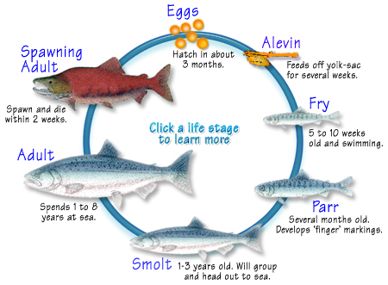

Slide 3
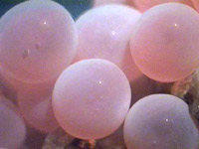
Eggs
After the adult salmon lay their eggs and covers them up with gravel they will die. Then approximately 2.5 months later the eggs will suddenly begin to open and the alevin will come out.

Slide 4
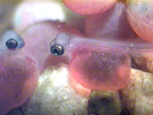
Alevin
The alevin will feed on its yolk sac until it is gone. Once the yolk sac is gone the alevin will come out from the gravel and become a fry.

Slide 5
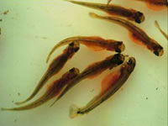
Fry
The fry are the shape of a small fish. The fry must find food on there own now. Then the fry will start to progress downstream to reach the ocean.

Slide 6
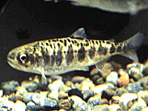
Parr
After a couple months of growing the fry will become larger and will get vertical markings on the flanks of its body. Then it will be a parr. Parrs are around six inches long.

Slide 7
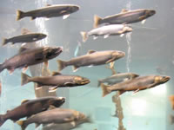
Smolt
The parr will grow and start to lose its stripes. Then it will form into a silverish pink color and will grow longer and will be called a smolt.

Slide 8
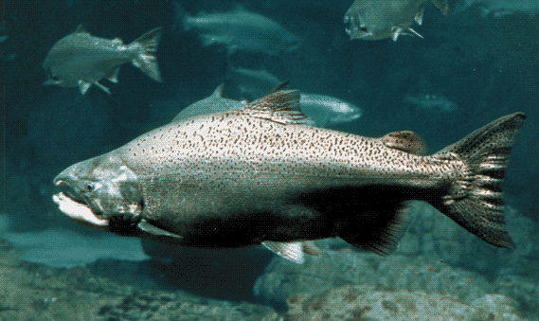
Adult
Adult salmon will spend one to eight years at the ocean to eat and grow. They will develop markings on there body. Once they are finished growing they will go to the stream they were born in to spawn.

Slide 9
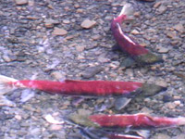
Spawning Adult
Once they get to the stream they ware born in they would have a spike on there lower jaw for fighting. And will have a red back. They will find a mate and will lay eggs. They will have around 3000 eggs. Then they will cover them up with gravel then die.

Slide 10
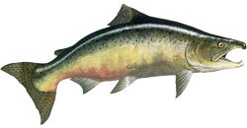
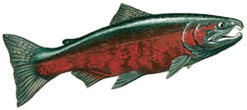
Different Types Of Salmon
• Also known as Kings
• The largest of the species, up to 125 lbs
• Can live up to seven years
• Spawn most often in large rivers or streams and in deep, fast water
• Flesh color may vary from white to pink to red
• Least abundant of North American
Chinook
• Also known as Silvers
• Spend one to two years in freshwater before migrating to sea
• Require small headwater streams for pre-migration period
• Originally one of the most commercially wanted after species; now depleted in many areas
Coho

Slide 11
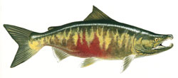
More Different Types Of Salmon
• Broadest geographic range of all the species, extending from California to Korea
• Spawn low in river systems
• Migrate to sea soon after hatching
• Flesh color may vary from white to pink to red
• Drier flesh well-suited for smoking
Chum
• Also known as Humpies
• Most abundant of the species
• Smallest of the species
• Often spawn in estuaries or lower reaches of rivers
• Migrate to sea soon after hatching
• Two-year life cycle with alternate even and odd year runs
• Lowest fat content of the species
• Frequently used for canning
Pink

Slide 12
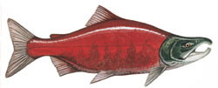
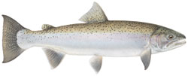
More Different Types Of Salmon
• Also known as Reds
• Darkest flesh of the species
• Name comes from the First Nation sukkai, meaning "fish"
• Greatest variety of life history patterns — spawn not only in rivers but also in lakes
• Often spend one to three years in freshwater before migrating to sea
• Some populations have become land-locked, and are known as kokanee salmon
Sockeye
Steelhead
• Live as much as four years in freshwater before migrating to sea
• May mature without ever leaving fresh water, in which case they are called rainbow trout
• Often do not die after spawning, but will re-migrate to the ocean
• Highly prized by anglers for their fighting spirit

Slide 13
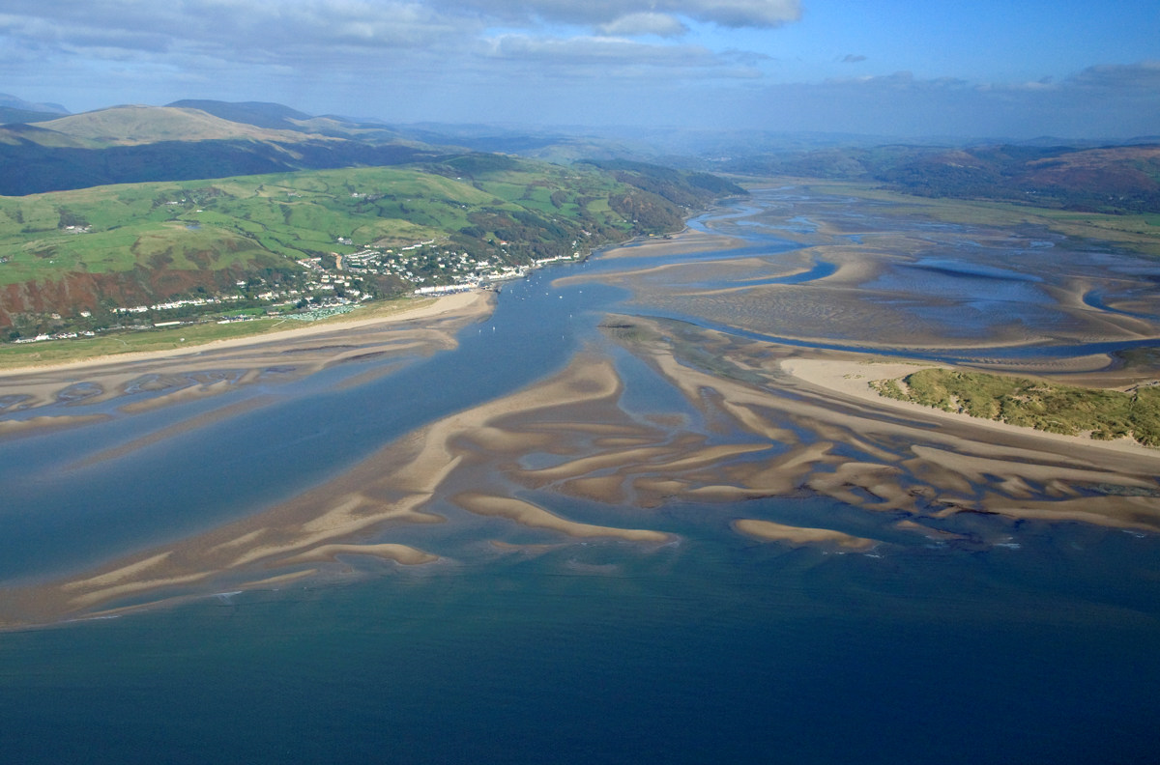
estuary
Footnotes
Alevin: a baby salmon
Fry: a slightly marcher salmon
Parr: a small camouflaged fish
Flank: the side of a person's or animal's body between the ribs and the hip
Smolt: a almost grown up salmon that is going to the ocean
Abundant: lost of
[ˈesCHo͞oˌerē ]
Estuaries: is a wide stream with lost of tiny pieces of land inside

Slide 14
Websites
http://www.discoverceredigion.co.uk/English/where/Coast/wildlifeandnaturalfeatures/Pages/River-estuaries.aspx
http://www.salmonnation.com/fish/meet_species.html
http://fullspectrumbiology.blogspot.com/2012/03/reasonable-amount-of-salmon-s-almon.html
http://www.fishex.com/seafood/salmon/salmon-life-cycles.html
http://www.bing.com/images/search?q=salmon+pictures&FORM=HDRSC2#view=detail&id=7406666493D649ABCDA5774CE585F76BCEA6BBCC&selectedIndex=5

Slide 15
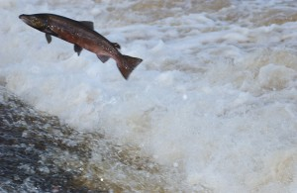
That’s All Folks

