Slide 1
Callie’s Salmon Report
Life History of Salmon

Slide 2
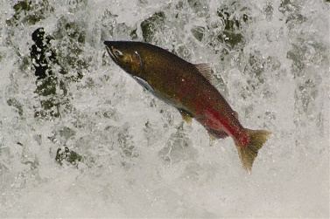
Salmon
Eggs
Alevin
Fry
Smolt
Ocean life
Spawning

Slide 3
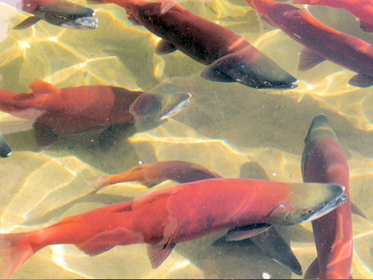
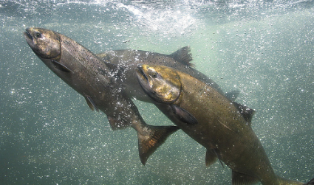
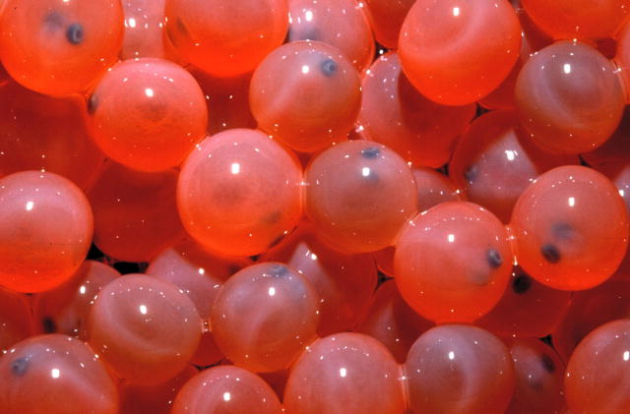
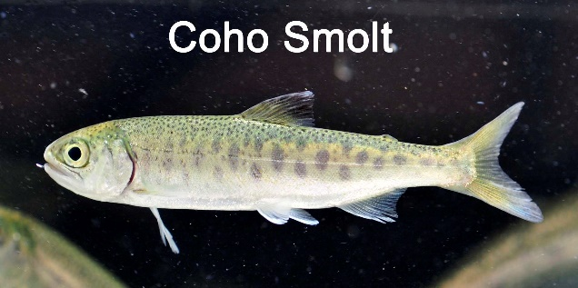
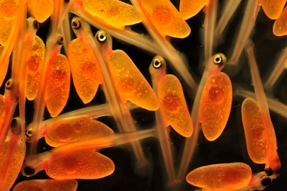
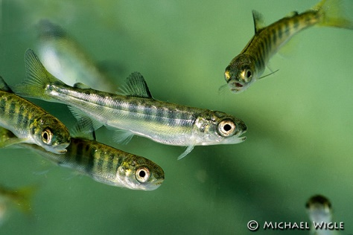
Life!!

Slide 4
Eggs
Lay in fresh water
6-12 weeks to hatch
Lay by female

Slide 5
alevin
Hatch from eggs
Eat egg sac

Slide 6
fry
Look like fish
Eat leftover from parents
Swim in schools

Slide 7
smolt
Change so that can go in salt water

Slide 8
Ocean life
Enter adulthood
Live in ocean
Do lots of growing

Slide 9
spawning
Go back where born
Done growing
Lay eggs
Protect eggs
Die

Slide 10
The End

